Slide 1
DECILE n
PERCENTILE

Slide 2
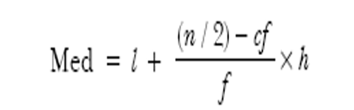
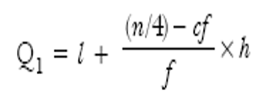

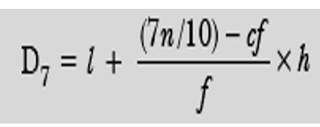
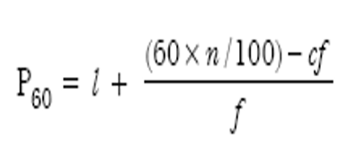
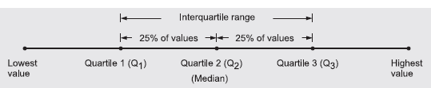

Slide 3

Deciles: The values which divides an ordered data set into 10 equal parts. The 5th decile is the median.
Deciles The values of observations in a data set when arranged in an ordered sequence can be divided into ten equal parts, using nine deciles, D_{i} (i = 1, 2,…, 9). The generalized formula for calculating deciles in case of grouped data is:
where the symbols have their usual meaning and interpretation.

Slide 4

Percentiles The values of observations in a data when arranged in an ordered sequence can be divided into hundred equal parts using ninety nine percentiles, P_{i} (i = 1, 2,…, 99).
Percentiles: The values which divides an ordered data set into 100 equal parts. The 50th percentile is the median.
where the symbols have their usual meaning and interpretation

Slide 5
Example : The following distribution gives the pattern of overtime work per week done by 100 employees of a company. Calculate median, first quartile, and seventh decile & 60 Percentile.
Calculate MEAN, MEDIAN, MODE, Q₁, Q2, Q3, D₇ and P₆₀.

Slide 6
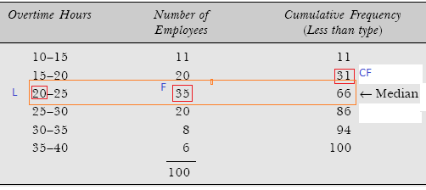
MEDIAN: Since the number of observations in this data set are 100, the median value is (n/2)th = (100 ÷ 2)th = 50th observation. This observation lies in the class interval 20–25.

Slide 7
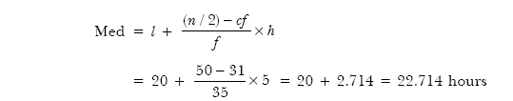
Applying the formula to get median overtime hours value, we have

Slide 8
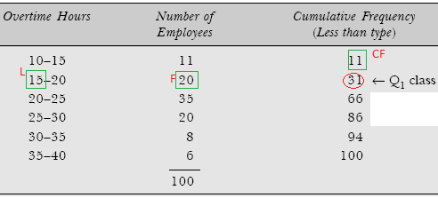
First quartile

Slide 9
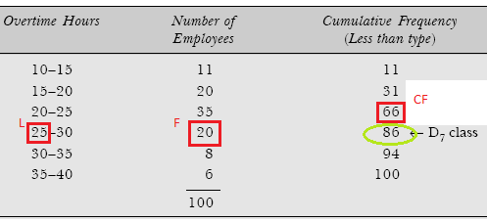
DECILE

Slide 10
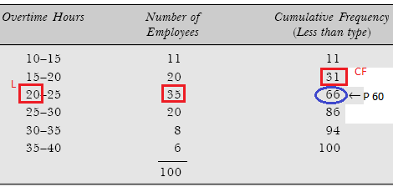
PERCENTILE

Slide 11
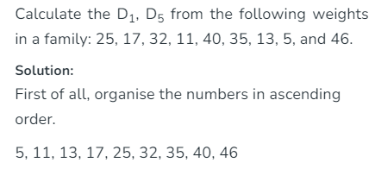

Slide 12
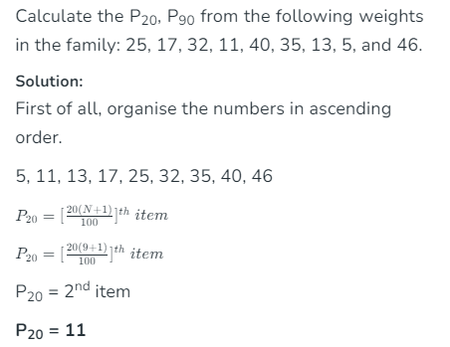
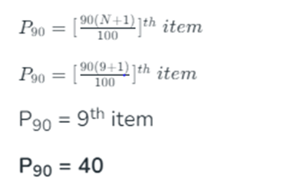

Slide 13
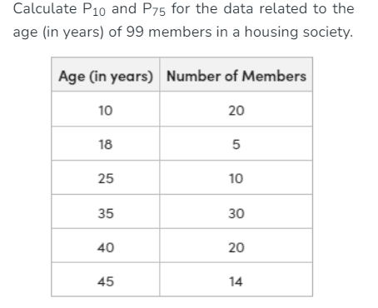

Slide 14
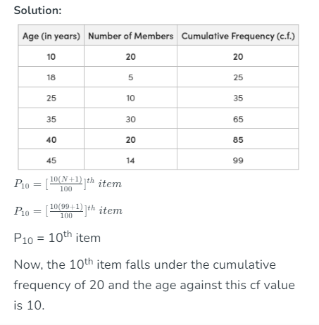

Slide 15
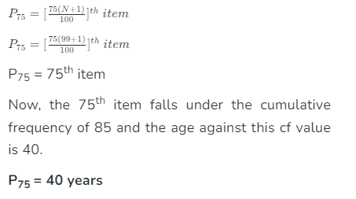

Slide 16
Find the following for a data of patients who have visited hospital on a particular day
Calculate MEAN, MEDIAN, MODE, Q₁, Q2, Q3, D₇ and P₆₀.
Marks | Frequency
10 – 20 | 1
20 - 30 | 3
30 - 40 | 11
40 - 50 | 21
50 - 60 | 43
60-70 | 32
70-80 | 9

Slide 17
Calculate MEAN, MEDIAN, MODE, Q₁, Q2, Q3, D₆ and P₈₀.
Marks | Frequency
0 - 10 | 8
10 – 20 | 17
20 - 30 | 30
30 - 40 | 33
40 - 50 | 42
50 - 60 | 40

